Slide 1


Slide 2
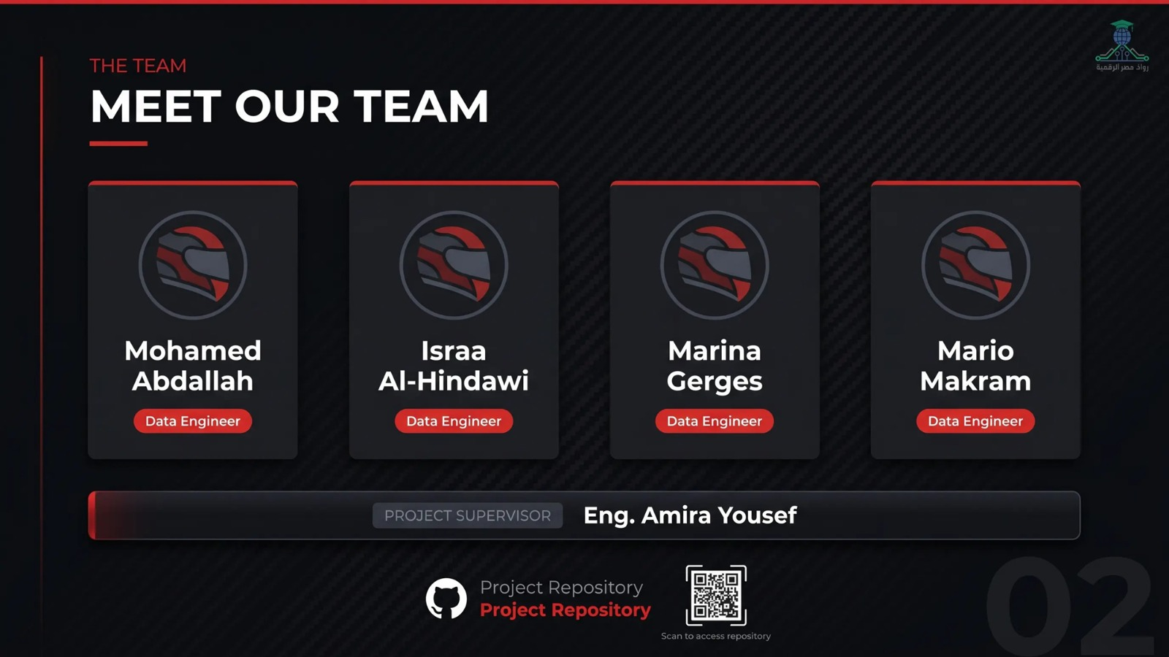

Slide 3
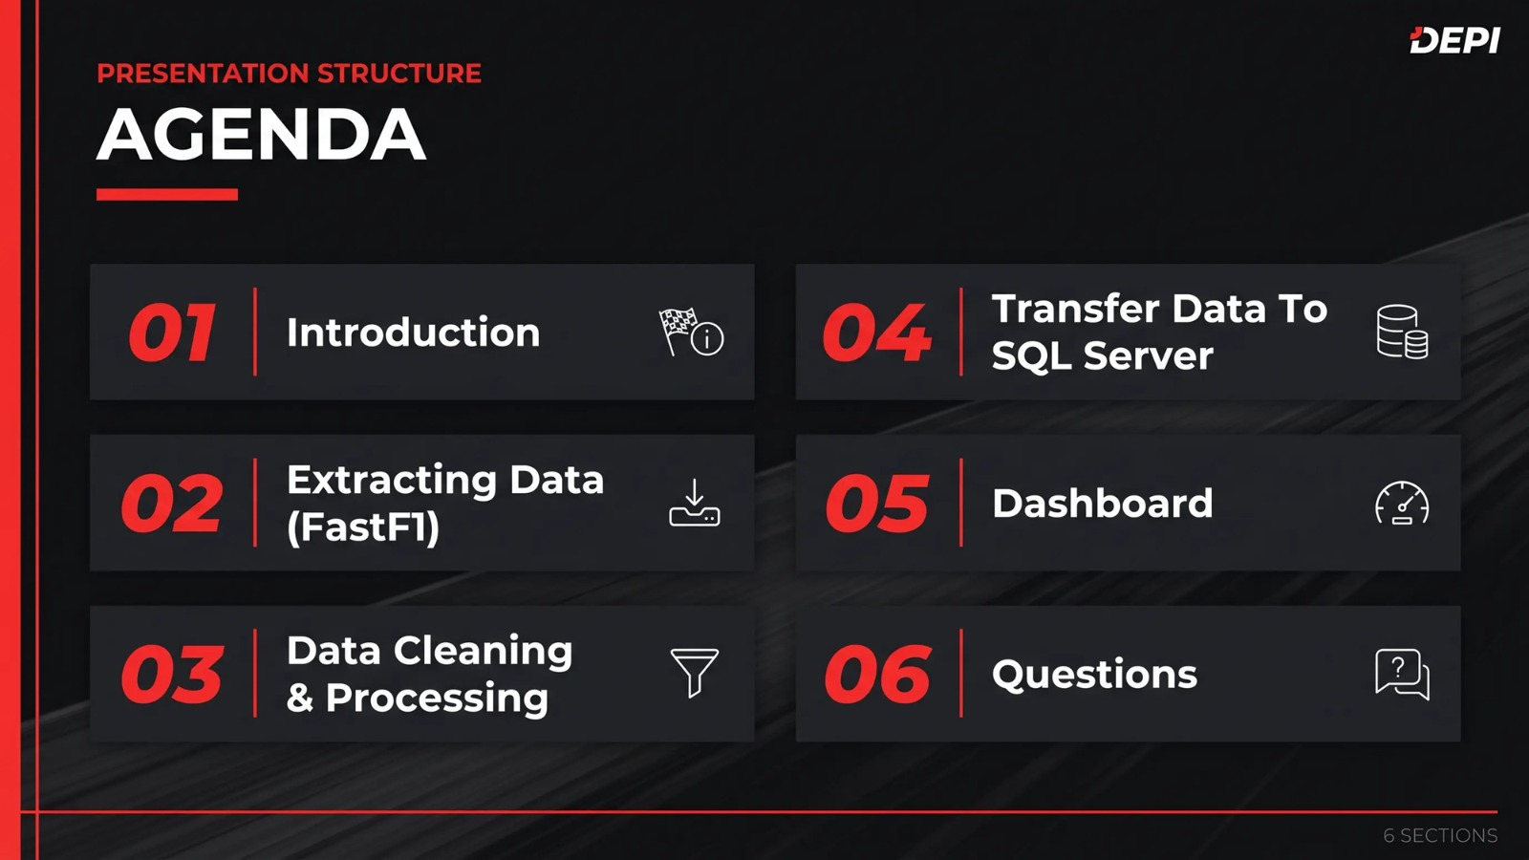

Slide 4
Introduction

Slide 5
Formula 1 & Data Engineering – Project
Summary
Formula 1 is one of the most data‑intensive sports, relying on big data and real‑time analytics.
Each car generates thousands of data points per race, including:
Speed
Tyre
Performance
Fuel consumption
The championship consists of multiple sessions:
Free practice
Qualifying
Main race
During each session, massive amounts of data are collected and analysed to support team strategy and improve performance.

Slide 6
Formula 1 & Data Engineering – Project
Project Objective
Apply Data Engineering principles to Formula 1 data using the FastF1 library.
Collect, clean, and process data from two races of the 2025 season.
Analyse the performance of two drivers: Max Verstappen and Lando Norris.
Extract Key Performance Indicators (KPIs) and compare driver performance using data analysis techniques.t

Slide 7

Project implementation phases
phase 1: Extracting Data
phase 2: Data Cleaning and processing
phase 3: Transfer Data To Stractured Database
phase 4: Insights &Visualization Dashboard

Slide 8


phase 1: Extracting Data
Extracting Data

Slide 9
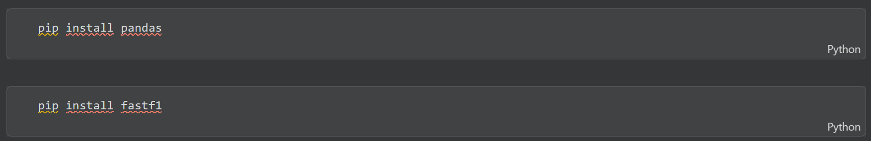
Installing Libraries
Step 1:: Install Pandas & Fast F1 Library

Slide 10
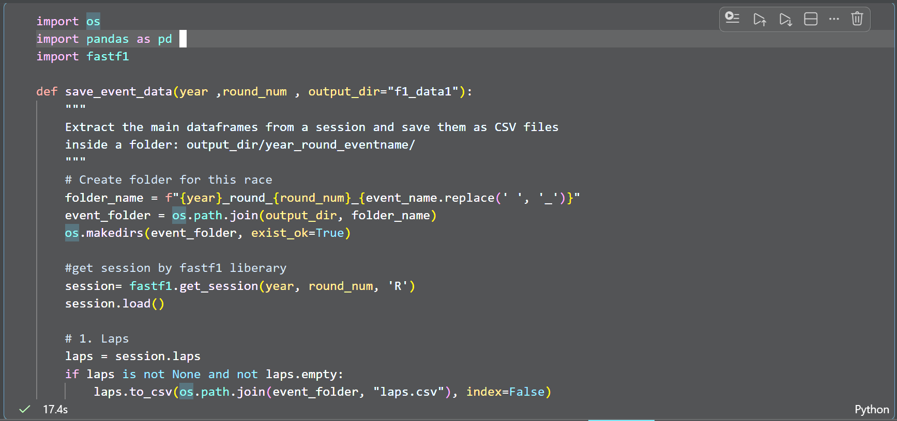

Extracting Data
Step 2: Import OS , Pandas, Fastf1 And Make A Function To Load Data In A Folder For Every Year We Call In The Function

Slide 11

🔍 The Most Important Tip :
Now We Will Load The Data From Fastf1 Library By Method (get_session)
We Use The Parameters :
Year : the year of the session or race
round_num : the number of race throw the record
The type of the race: R ---- refer to Race
Hint:
(The type of the race divide into many types : R ----- race , FP1---- free practice1 , FP2---- free practice 2, Q1 ---- qualifying 1 , Q2 ---- qualifying 2 )

Slide 12
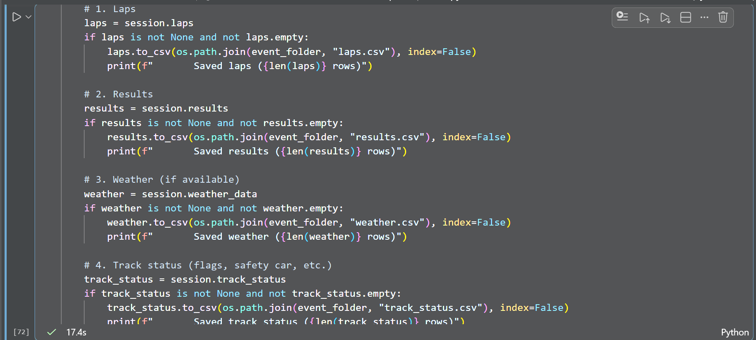
Step 3: Then we start to get all data we want like (laps , results , telemetry , pit-stop, weather , track status ) and save it into a csv file

Slide 13
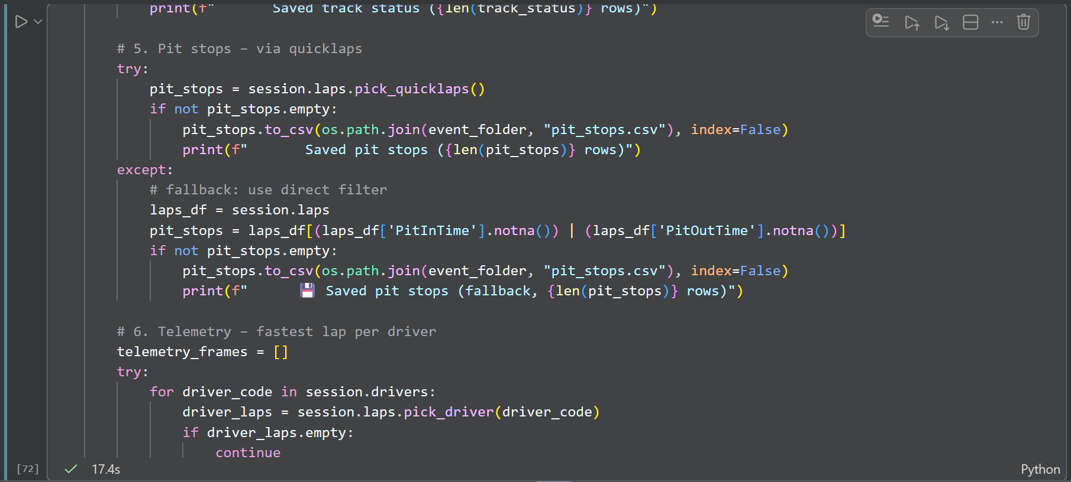
Step 4: we use try and except when we get pit stops data and telemetry data because if the try first solution don’t work so we use the other solution and get the data manually.

Slide 14
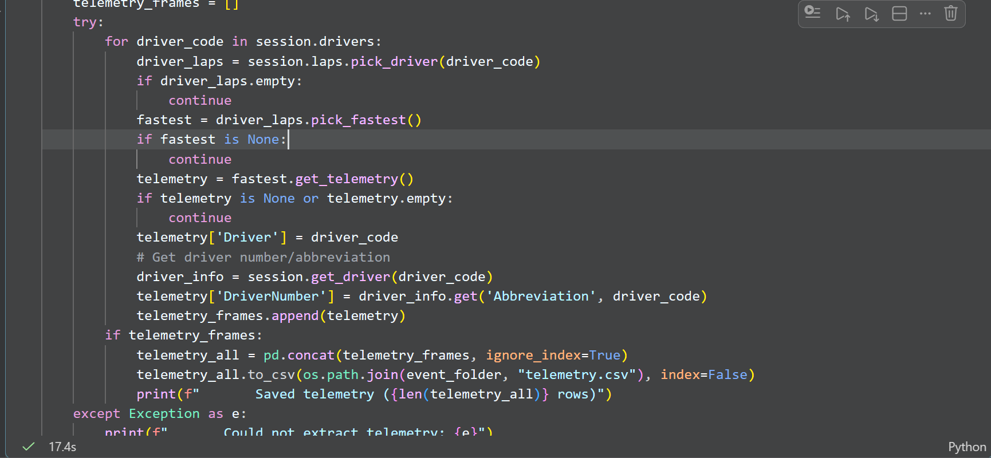
Step 5: we get the telemetry data by picking the fastest lap for the drivers because the data is very big for all laps for all of the drivers
Then we add a driver column and add the driver code on it and concat all of dataframes in one csv file

Slide 15
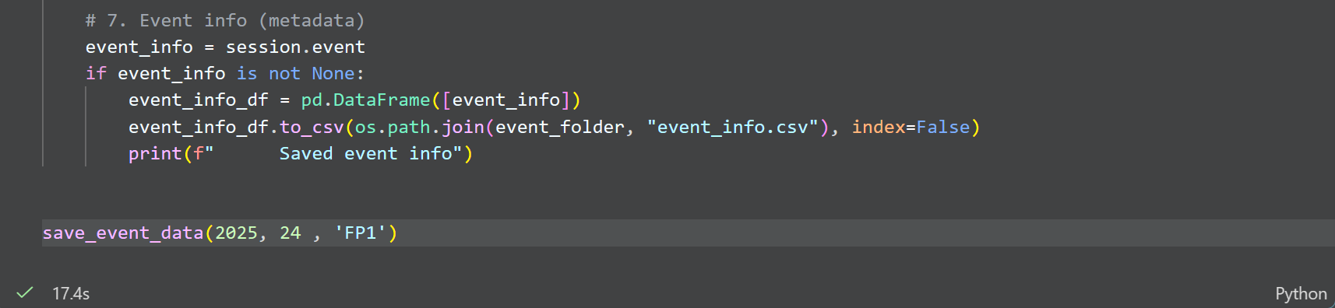
Step 6: Then we get event info and record it in dataframe and then to csv file .
Finally we recall the function and start to requesting all of our data :

Slide 16

phase 2: Data Cleaning and processing
Data Cleaning & processing

Slide 17
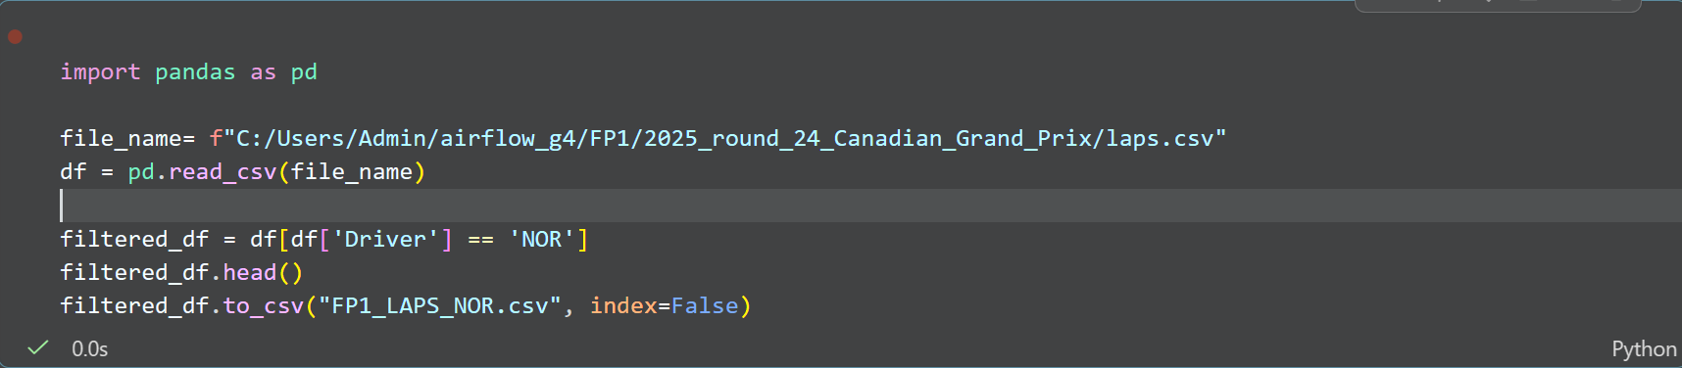
Data Cleaning (Filtration)

Slide 18
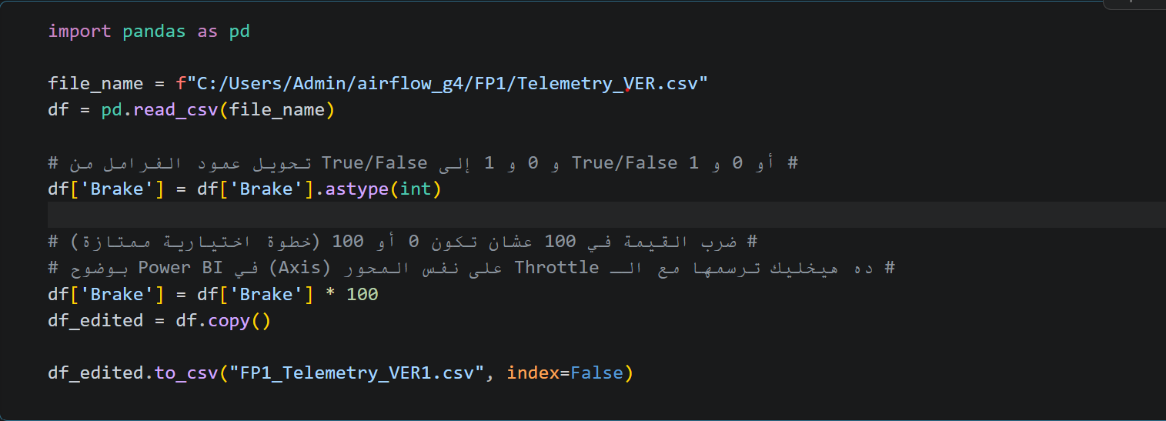
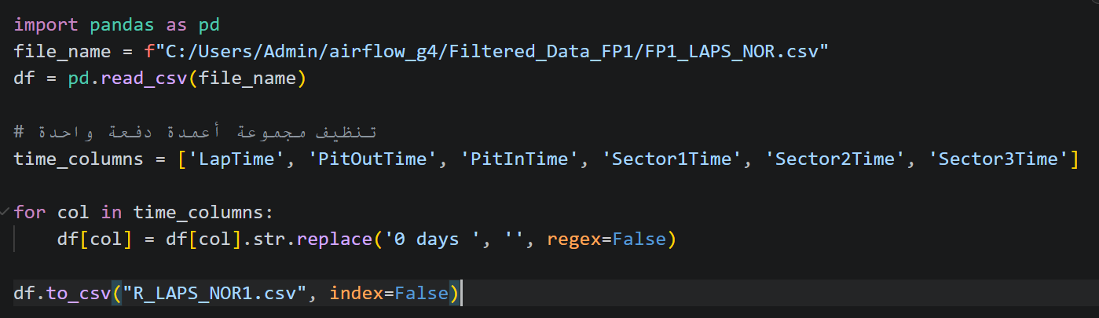
Data Processing
Transfer data type into integer:
Clean the lap times data :

Slide 19


phase 3: Transfer Data To Stractured Database
SQL Database

Slide 20
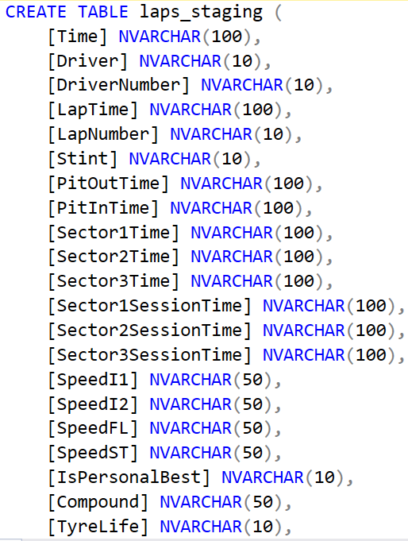
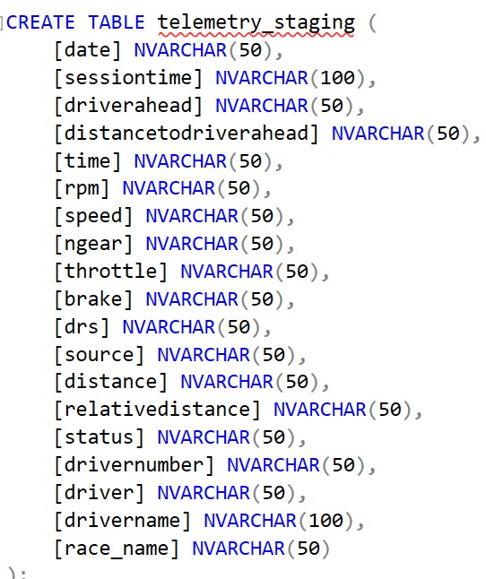
Database & Staging Tables
Created database fast_f1.Created two staging tables: laps_staging and telemetry_staging. All columns data type NVARCHAR. VARCHAR to accept any raw CSV data without conversion errors

Slide 21
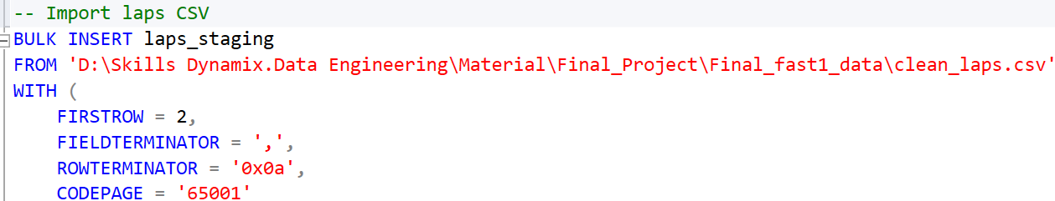
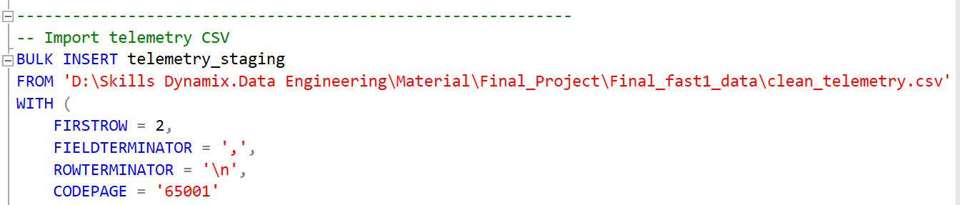
Bulk Insert from CSV
Used BULK INSERT to load clean_laps.csv and clean_telemetry.csv into staging tables.Handled format issues: 0 days HH:MM:SS.ms, decimal numbers (e.g., 1.0), and boolean strings (True/False).

Slide 22
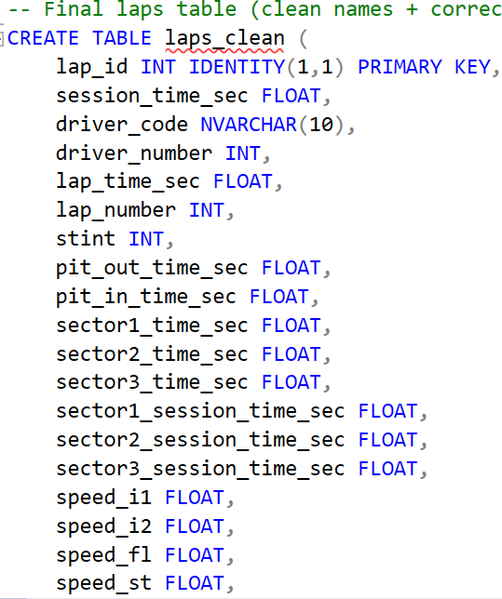
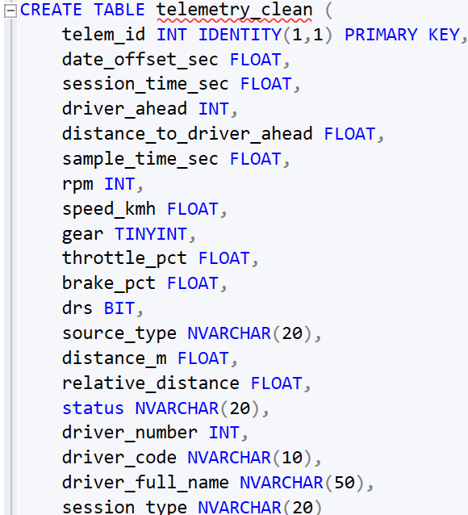
Clean Tables & Type Conversion
Created final tables: laps_clean and telemetry_clean with proper data types (FLOAT, INT, BIT, DATETIME2).
Converted time strings to seconds (e.g., 0 days 01:55:06.327 → 6946.327 seconds).Converted '1.0' to integer 1 using string manipulation.
Converted 'True'/'False' to 1/0 (BIT).Converted LapStartDate to DATETIME2.
Verified that all 232 lape row and 17,906 telemetry rows.

Slide 23
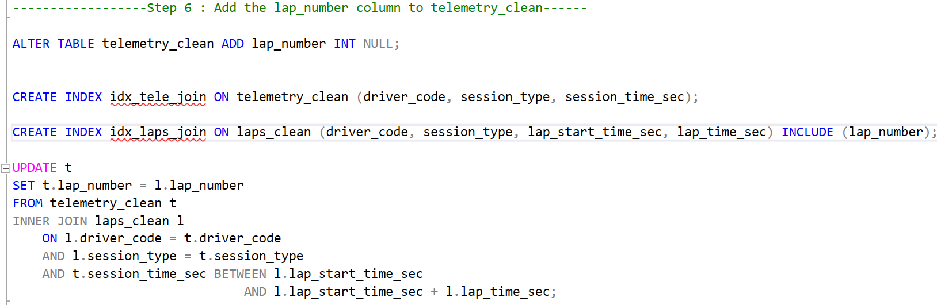
Add Lap Number to Telemetry
Telemetry originally had no LapNumber. Added column lap_number to telemetry_clean.
Populated it using a time‑based join:
Verified that all 17,906 telemetry rows

Slide 24
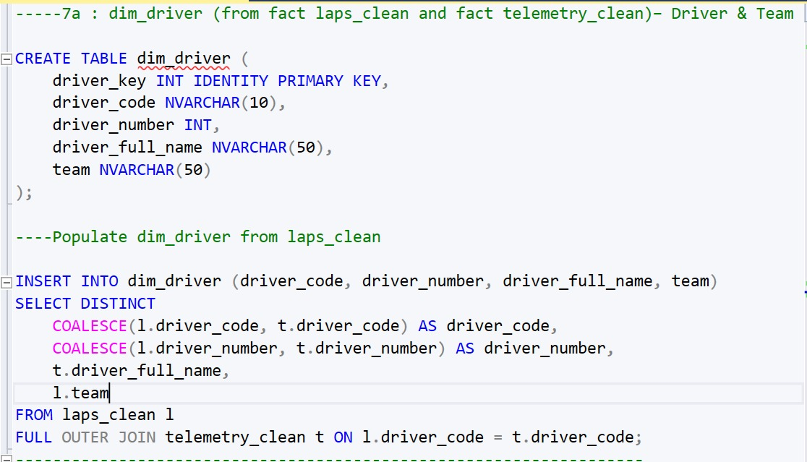
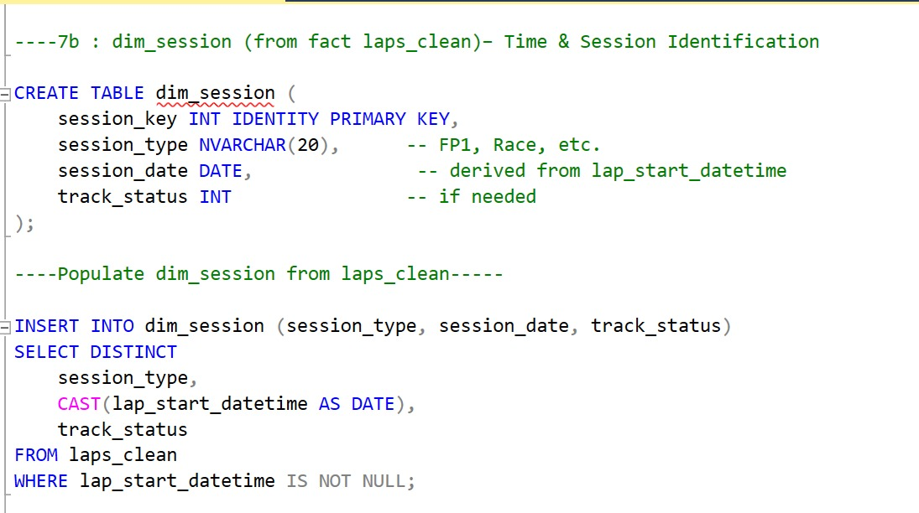
Build Star Schema (Dimensions)
- Created dimension tables from lape_clean table and populate theme. : dim_driver (driver_code, driver_number, driver_full_name, team)
- dim_session (session_type, session_date, track_status)
- dim_tyre_stint (stint_number, compound, tyre_life_at_start, fresh_tyre)
- dim_pit (pit_in_time_sec, pit_out_time_sec)
- dim_track (track_status, position, deleted, deleted_reason)
- dim_data_quality (is_accurate, fastf1_generated)

Slide 25
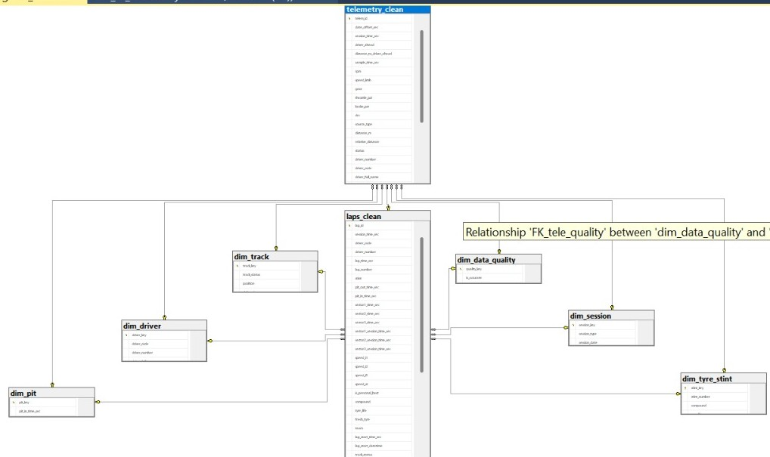

Slide 26
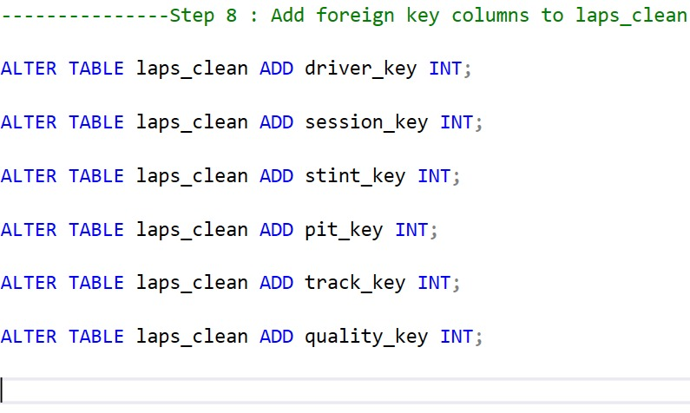
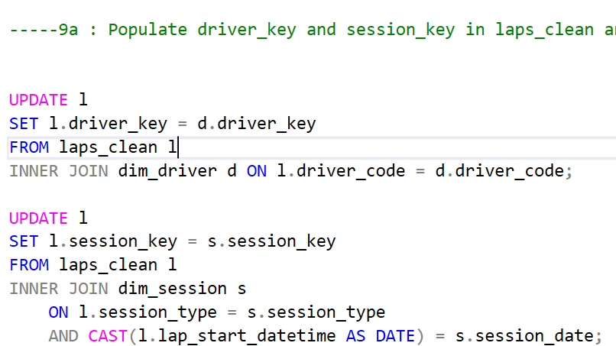
Add Forein Keys to laps_clean
Added driver_key, session_key, stint_key, pit_key, track_key, quality_key to laps_clean. And Populated them by joining with the corresponding dimension tables.

Slide 27
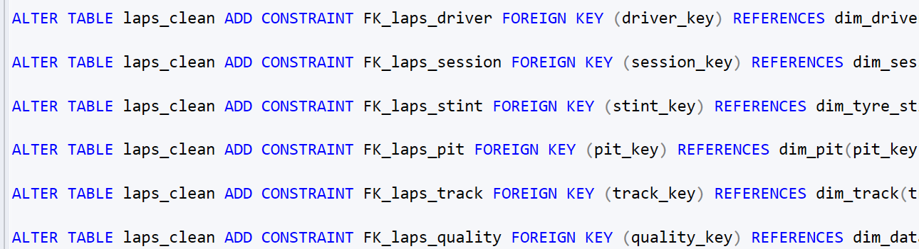
Add foreign key constraints for laps_clean
- FK_laps_driver
- FK_laps_session
- FK_laps_stint
- FK_laps_pit
- FK_laps_track
- FK_laps_quality

Slide 28
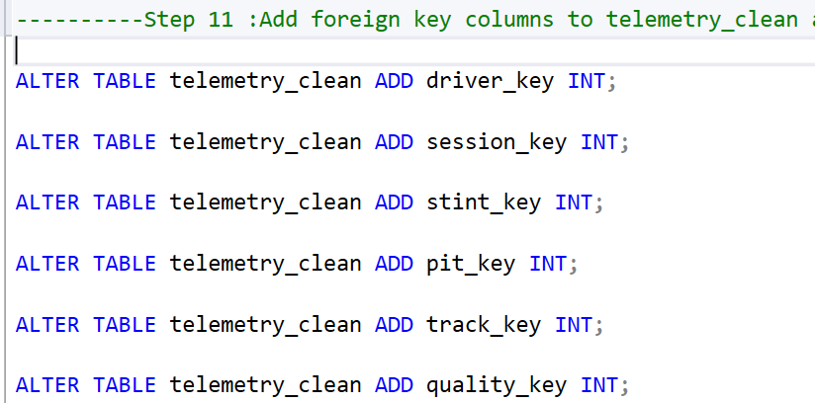
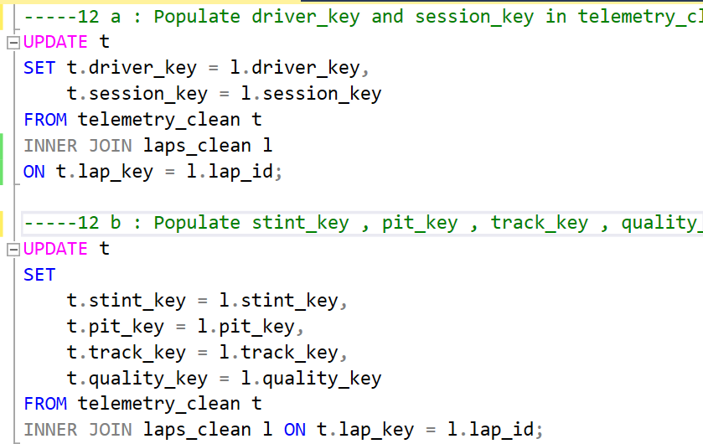
Add foreign key columns to telemetry_clean and Link it to dimensions.
And Populate the foreign keys in telemetry_clean by inner joining with lape_clean using laps_key.
- driver_key
- session_key
- stint_key
- pit_key
- track_key
- quality_key

Slide 29
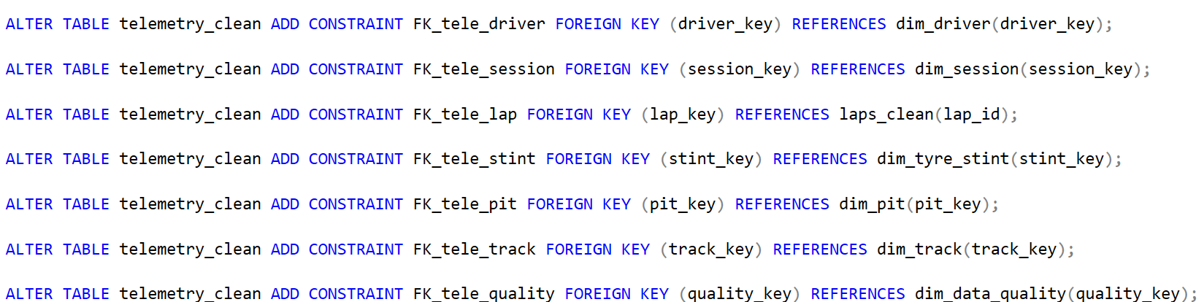
Add foreign key constraints for telemetry_clean
- FK_tele_driver
- FK_tele_session
- FK_tele_lap
- FK_tele_stint
- FK_tele_pit
- FK_tele_track
- FK_tele_quality

Slide 30
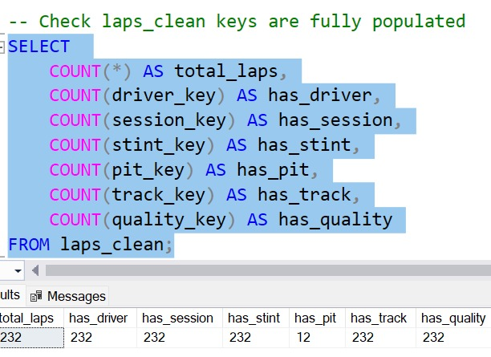
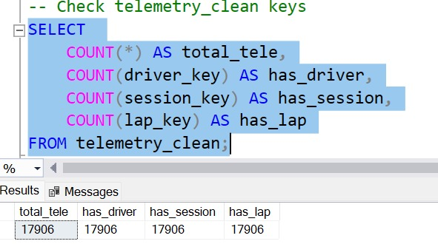
Verification
Ran validation queries:
- laps_clean: 232 laps – all have driver, session, stint, track, and quality keys; 12 laps have pit keys.
- telemetry_clean: 17,906 rows – all have driver, session, and lap keys.

Slide 31

phase 4: Insights &Visualization Dashboard
Dashboard

Slide 32
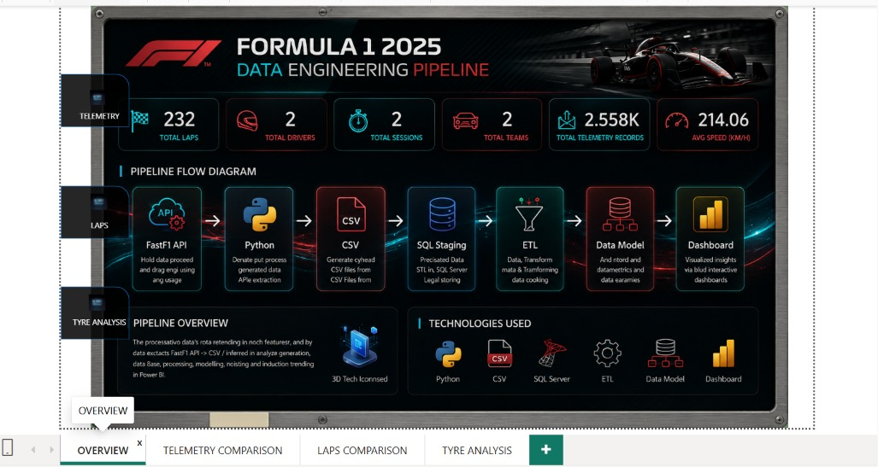
Overview
This page explains the complete data engineering pipeline of the project, from collecting Formula 1 telemetry data using FastF1 API to transforming and visualizing it in Power BI.
It also presents key statistics such as total laps, drivers, sessions, telemetry records, and average speed.

Slide 33
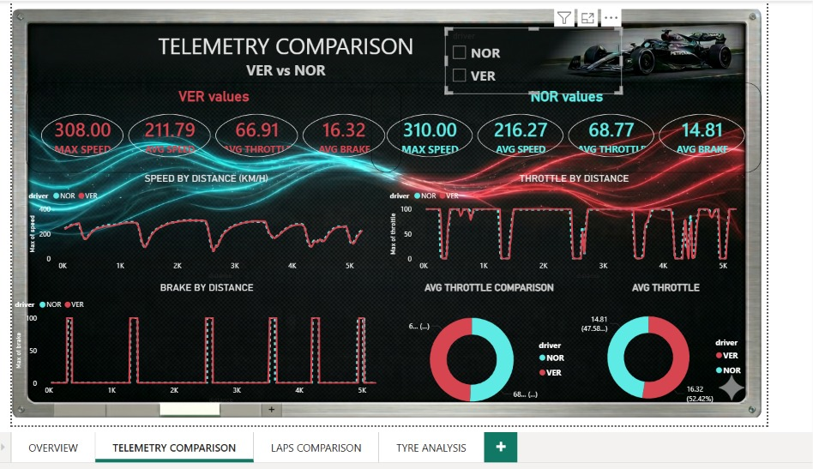
Telemetry Comparison
This page compares the telemetry performance of VER and NOR by analyzing speed, throttle, and brake behavior across the track.
The visualizations help identify driving style differences, top speed performance, and car control efficiency.

Slide 34
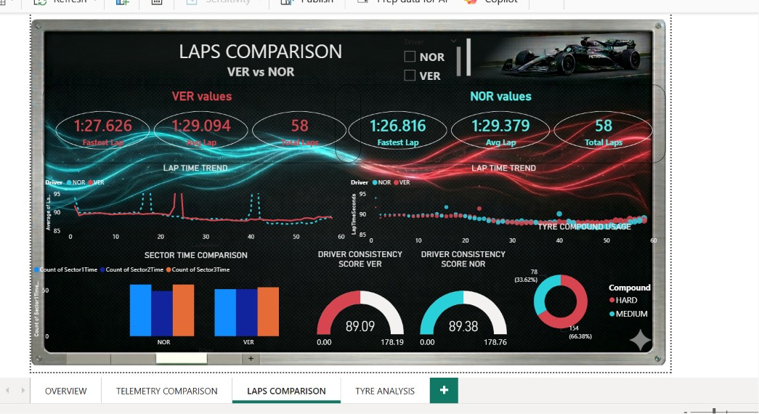
Laps Comparison
This page analyzes lap performance and consistency using lap times, sector analysis, and tyre usage comparison.
It highlights how small time differences and driving consistency can impact overall race performance.

Slide 35
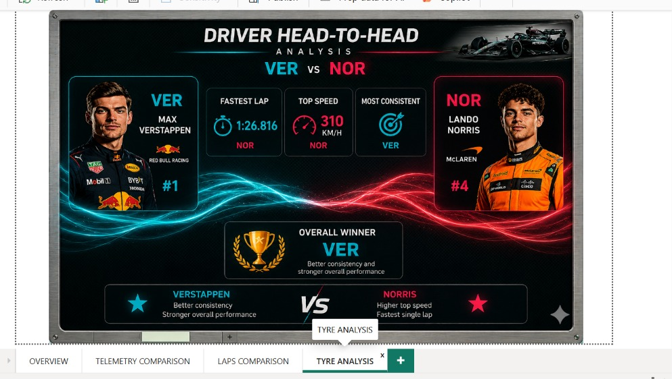
Driver Head-to-Head
This page summarizes the overall comparison between VER and NOR using key performance indicators and race insights.
It provides a final performance evaluation based on speed, lap time, and driving consistency.

Slide 36
